Slide 1
convex presentation

Slide 2
Agenda
Introduction
Data Loading and Cleaning
Data Processing
Descriptive Statistics
Portfolio Optimization (Convex Case)
Non-Convex Scenario
Risk-Return Analysis
Financial Trends Visualization
Final Insights

Slide 3
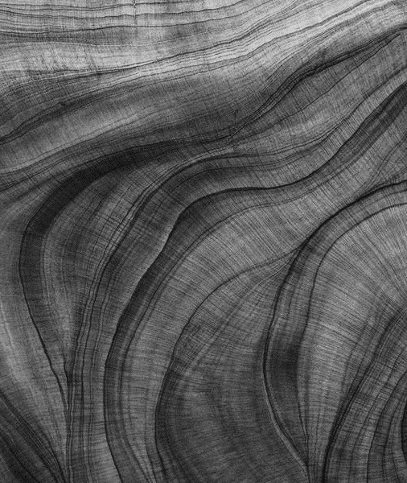
Introduction
Objective: To optimize a financial portfolio using convex optimization techniques.
Dataset: Daily stock prices for various companies over five years.

Slide 4
Data Loading and Cleaning
Steps:
Load Data: Load a CSV file containing stock data using pandas.
Check Missing Data: Identify and remove rows with missing values.
Output: Cleaned dataset ready for analysis.

Slide 5
Data Processing
Filter Stocks: Focus on selected stocks (AAPL, GOOGL, MSFT).
Date Handling: Convert date columns to datetime format and sort data.
Daily Returns: Calculate daily percentage changes in closing prices for each stock.
Matrix Preparation: Pivot the data to create a returns matrix.

Slide 6
Descriptive Statistics
Key Metrics: Calculate mean returns and covariance matrix for the daily returns.
Visualization:
- Use sns.heatmap to display the covariance matrix.

Slide 7
Portfolio Optimization (Convex Case)
Optimization Variables: Define weights for portfolio allocation using cvxpy.
Constraints:
Weights sum to 1.
Non-negative weights.
Target portfolio return ≥ 0.0005.
Objective: Minimize portfolio risk (variance).
Check Convexity: Verify if the covariance matrix is positive semi-definite.
Results:
Optimal weights.
Expected portfolio return.
Portfolio risk.

Slide 8
Non-Convex Scenario
Matrix Conversion: Convert the covariance matrix to a non-convex form
by altering eigenvalues.
Regularization: Use a function to make the matrix positive semi-definite again.
Optimization: Re-run portfolio optimization with the regularized covariance matrix.
Results: Compare weights, returns, and risk with the convex case.

Slide 9
Risk-Return Analysis
Tradeoff Analysis:
Group stocks by risk (standard deviation) and return (mean daily return).
Plot scatter graph for risk-return tradeoff.
Comparison: Visualize risk and return for convex and non-convex cases.

Slide 10
Financial Trends Visualization
Stock Prices Over Time: Line plot for individual stock trends.
Portfolio Performance: Aggregate portfolio value over time.

Slide 11
Final Insights
Comparative Insights: Show differences between convex and
non-convex optimization results.
Practical Implications: Discuss how the results guide investment decisions.

Slide 12
Thank you

